Slide 1

Using AI as a Data Science Research: Changes, Capabilities, and Ethics
In the last two years we have seen unprecedent progress in the capabilities of large language models. In the last month, several models have emerged that show advanced reasoning capabilities. In this talk, I will focus on the capabilities and impact of the most recent models – particularly OpenAI-o1 Preview, Claude 3.5 Sonnet, and ChatGPT 4o with advanced voice features. I will also talk more in depth about the “AI Scientist” software that was released in August. I will focus on the implications this has on our research in our productivity, workflow, and the ethical implications it has for our work.
John Wallin
Director of the Computational and Data Science PhD Program
Middle Tennessee State University

Slide 2
The Plan
How does Deep Learning and LLM systems work
Benchmarks and recent progress on Foundation Models
Using AI as a Data Scientist
Applications
Ethics
Implications

Slide 3
Generating Functions, Data, and Models
Generating Function – the underlying function that creates a data set. If we know this function, we have the perfect model of a system.
Data – Output from the generating function. This may involve random spacing in X values and noise.
Model – A functional form with optimized coefficients used to fit data. Ideally, this should reproduce the generating function.

Slide 4
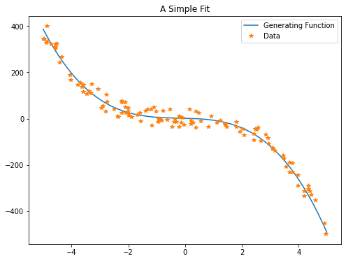
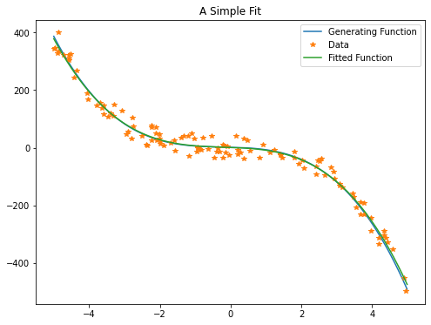
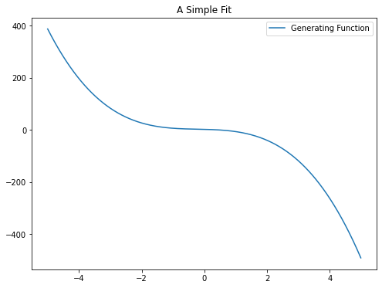
Cubic Generating Function and Cubic Model
DATA N=120
X Y
-2.9468 48.5658
4.9127 -451.7867
2.9092 -84.0606
-3.5901 117.2356
3.4592 -157.8959
-4.4253 244.3020
2.0622 -71.6911
0.4772 25.5488
-2.7738 105.4164
1.9182 -54.7380
…
generating function:
y = -2.600 x^0 + 4.400 x^1 - 4.600 x^2 - 0.100 x^3
fitted model:
y = -2.593 x^0 + 4.445 x^1 - 3.862 x^2 + 1.980 x^3

Slide 5
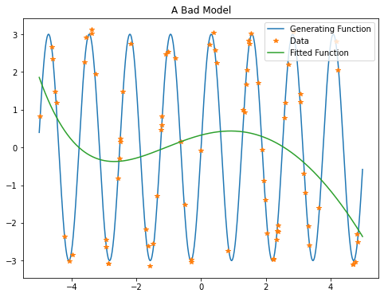
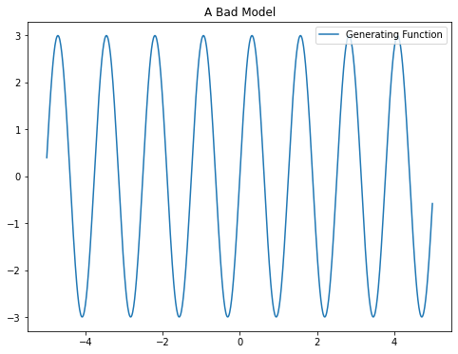
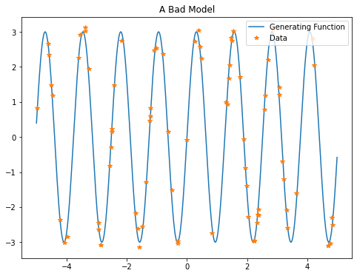
A Bad Model
generating function:
y = 3*sin(5*x)
X Y
2.5810 0.7884
-0.6294 0.1451
-0.3058 -2.9623
-4.4691 1.1832
2.3828 -2.0652
-1.2156 0.5980
3.1759 -0.7026
-3.3902 3.1167
1.7645 1.7206
-4.9827 0.8189
fitted model :
y = -0.000 x^0 + 0.003 x^1 - 0.022 x^2 - 0.097 x^3 + 0.224 x^4 + 0.326 x^5

Slide 6
A quick note about Data
Continuous data – real numbers/floating point variables
Examples:
1.23567e10
(3.466, 3.45623, 333.003242)
We typically use regression with continuous metrics for this type of data
Categorical or Discrete data – data consisting of a finite (and usually small number) of possibilities
Examples:
Academic Major: Physics, Chemistry, Accounting…
Academic level: Undergraduate, Graduate (Masters), Graduate (Doctoral)
Requires slightly different metrics and approaches

Slide 7
A generalized model
If your model doesn’t match your generating function, you will never get a satisfactory fit.
Neural networks are a form of general model that can be applied to many situations successfully.
They tend to be applied on categorical data and classification, but regression is possible.
They are successful at many models where there is a large data set with complex inputs and a finite number of outputs

Slide 8
Key elements of a neural network
The Network
Input layer, Hidden layers, Output layer
Each layer has a set of weights which takes the input of the layer and turns it into output to the next layer
Activation functions – to sharpen the output of each layer and keep it bound between 0 and 1 (typically)
A metric for measuring the error of the predictions
A method of taking the error and using it to update the weights of the network
A loop to iterate over the prediction, error calculation, and update of the weights

Slide 9
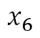
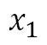
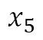
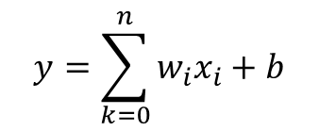
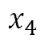
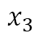
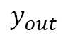
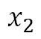
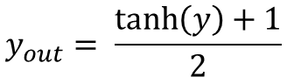
The Artificial Neuron or Perceptron
$$x_{1}$$
$$y=\sum_{k=0}^{n}{w_{i}x_{i}+b}$$
$$y_{out}$$
$$x_{2}$$
$$y_{out}= \frac{\tanh\left(y\right)+1}{2}$$
$$y_{out}$$
$$x_{3}$$
y
$$y_{out}$$
$$x_{4}$$
$$y_{out}$$
Neuron
Activation
layer
$$x_{5}$$
$$y_{out}$$
$$x_{6}$$
$$y_{out}$$

Slide 10
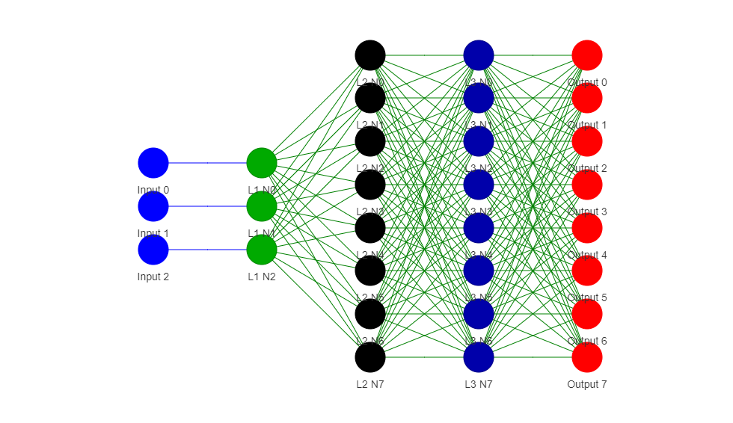
Neural Networks
Hidden Layer
Output Layer
Predicted Outputs
Input Data
Input Layer
Weights

Slide 11
Updating the Weights
The process of updating weights is called Back Propagation
Mathematically, we calculate the derivative of the error with respect to the input values and the two elements in the layers model – weights and biases.
We apply these derivatives to differentially update the weights using numerical integration layer by layer.

Slide 12
Training a Neural Network
Configure the data into a training and testing set
Define a network architecture
Neurons per layer, connectivity, types of layer
Scramble the training data
Feed a set of input values from the training data into the network
Predict the output
Calculate the error between the prediction and the actual values
Use the difference to update the weights in the network
Repeat steps 2 to 7 until the accuracy is satisfactory or until the network performance stops improving
Verify the performance using the testing data.

Slide 13
Sample codes
simple-nn.ipynb – a code to understand how neural nets work mathematically
https://towardsdatascience.com/math-neural-network-from-scratch-in-python-d6da9f29ce65
https://colab.research.google.com/drive/1k7hvKuNA1ImQTLP09siMptrlb7IRFYZp?usp=sharing
mnist-simple.ipynb – a simple dense network
https://colab.research.google.com/drive/1Ia090F9JfQj1kz8aA1SOLj3a33dJ2xwV?usp=sharing
mnist.ipynb – An example keras CNN
https://keras.io/examples/vision/mnist_convnet/
https://colab.research.google.com/drive/10OOq8UB7T1OnN87UqFC_JjBpi5rFySVZ?usp=sharing

Slide 14
Data for an XOR (Exclusive OR) Logic Circuit
Input 1 | Input 2 | Output
0 | 0 | 0
0 | 1 | 1
1 | 0 | 1
1 | 1 | 0
Input 1 | Input 2
0 | 0
0 | 1
1 | 0
1 | 1

Slide 15
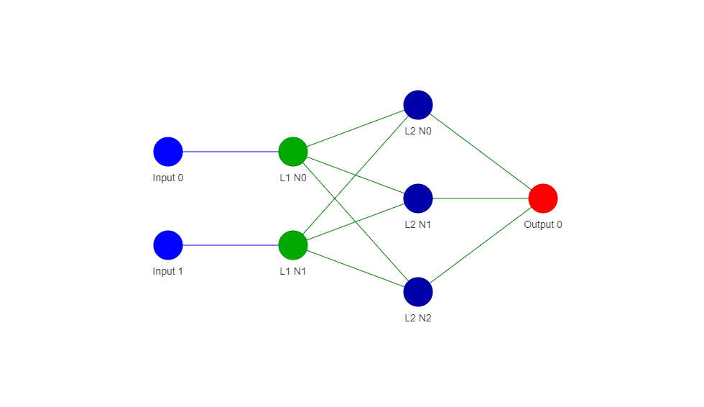
A very simple neural network
9 weights
2 inputs
1 output

Slide 16
Example: Binary to Decimal Converter
Input 1 | Input 2 | Input 3 | Out 7 | Out 6 | Out 5 | Out 4 | Out 3 | Out 2 | Out 1 | Out 0
0 | 0 | 0 | 0 | 0 | 0 | 0 | 0 | 0 | 0 | 1
0 | 0 | 1 | 0 | 0 | 0 | 0 | 0 | 0 | 1 | 0
0 | 1 | 0 | 0 | 0 | 0 | 0 | 0 | 1 | 0 | 0
0 | 1 | 1 | 0 | 0 | 0 | 0 | 1 | 0 | 0 | 0
1 | 0 | 0 | 0 | 0 | 0 | 1 | 0 | 0 | 0 | 0
1 | 0 | 1 | 0 | 0 | 1 | 0 | 0 | 0 | 0 | 0
1 | 1 | 0 | 0 | 1 | 0 | 0 | 0 | 0 | 0 | 0
1 | 1 | 1 | 1 | 0 | 0 | 0 | 0 | 0 | 0 | 0
Input 1 | Input 2 | Input 3
0 | 0 | 0
0 | 0 | 1
0 | 1 | 0
0 | 1 | 1
1 | 0 | 0
1 | 0 | 1
1 | 1 | 0
1 | 1 | 1

Slide 17
A dense neural network
3 inputs
8 outputs
1 hidden layer
Number of Weights =
3 x 8 x 8 x 8 = 1532

Slide 18
Word2Vec an early example of embedding changing words into vectors
Word2Vec is a program created in 2013 by Tomas Mikolov and other at Google.
It uses to algorithm
“Continuous Bag of Words” – to predict the next word in a sentence
“Skip-Gram” – predicts words missing in a sentence give the context
Training is done using positive and negative examples to capture semantic and syntactic relationships

Slide 19
An Example of Word2Vect
The word “Apple” becomes: [ 0.64158976, -0.21014647, 0.588113 , ..., -0.40470958, 0.99179345, 0.76531297]
The word “Orange” becomes: [-0.08535365, -0.31420925, -0.09664118, ..., 0.5893312 , 0.44359636, 0.20136227]
These don’t look very similar – but if you measure the distance between them using a technique called “cosine similarity”, they are very close together compared to other words.

Slide 20
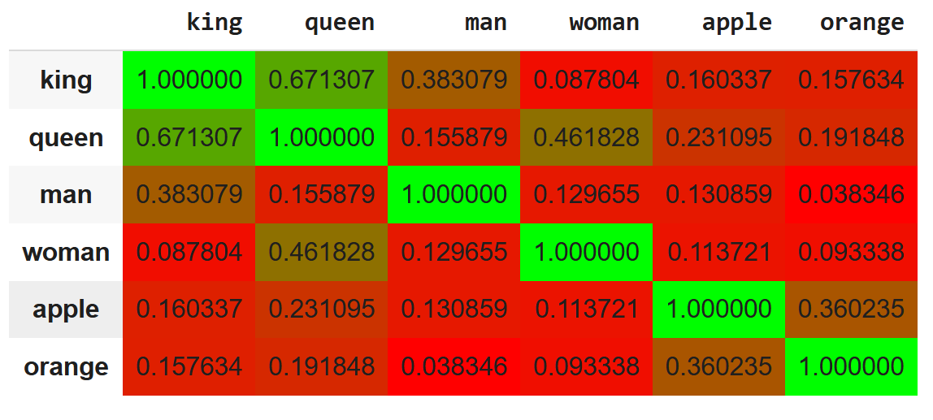
Cosine similarity table between some common words

Slide 21
Word Arithmetic
Result of 'president - country + company': ['company', 'ceo', 'corporation', 'president', 'executive’]
Result of 'king - man + woman': ['queen', 'elizabeth', 'princess', 'woman', 'her']

Slide 22
Document Similarity
My student Ian Perry did an experiment to look at the similarity between AI summarized text and the human summaries of the same text.
100 Astrophysics papers on colliding galaxies were extract from ARXIV
The abstracts were separated from the main paper.
The AI created a summary of the main papers.
We did a comparison between the paper summaries by the AI and the original human created abstracts

Slide 23
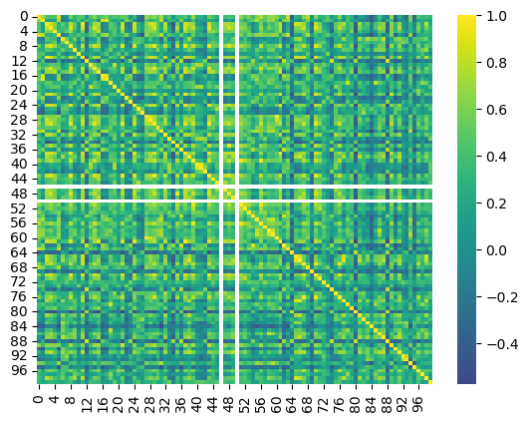
Similarity score between AI summaries and human abstracts
Human Abstract
AI generated Summary

Slide 24
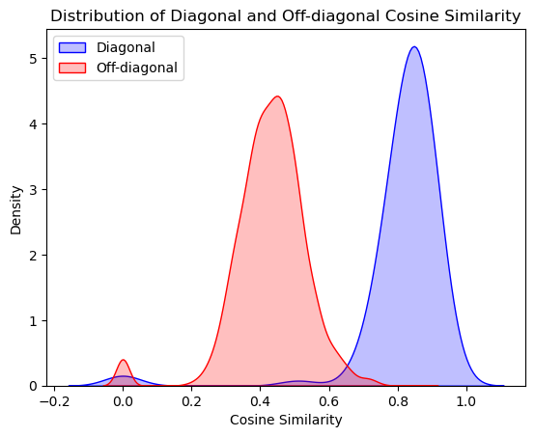
Similarites between actual matches and non-matches
Specificity = 0.97

Slide 25

What is artificial intelligence?
Artificial intelligence, or AI, is technology that enables computers and machines to simulate human intelligence and problem-solving capabilities. (IBM https://www.ibm.com/topics/artificial-intelligence)
Traits of intelligence
reason, use strategy, solve puzzles, and make judgments under uncertainty
represent knowledge, including common sense knowledge
plan
learn
communicate in natural language
if necessary, integrate these skills in completion of any given goal
https://en.wikipedia.org/wiki/Artificial_general_intelligence

Slide 26
Traits of intelligence
reason, use strategy, solve puzzles, and make judgments under uncertainty
represent knowledge, including common sense knowledge
plan
learn
communicate in natural language
if necessary, integrate these skills in completion of any given goal
https://en.wikipedia.org/wiki/Artificial_general_intelligence

Slide 27
Artificial General Intelligence
Artificial general intelligence (AGI) is a type of artificial intelligence (AI) that matches or surpasses human capabilities across a wide range of cognitive tasks. This is in contrast to narrow AI, which is designed for specific tasks. AGI is considered one of various definitions of strong AI. (https://en.wikipedia.org/wiki/Artificial_general_intelligence)

Slide 28
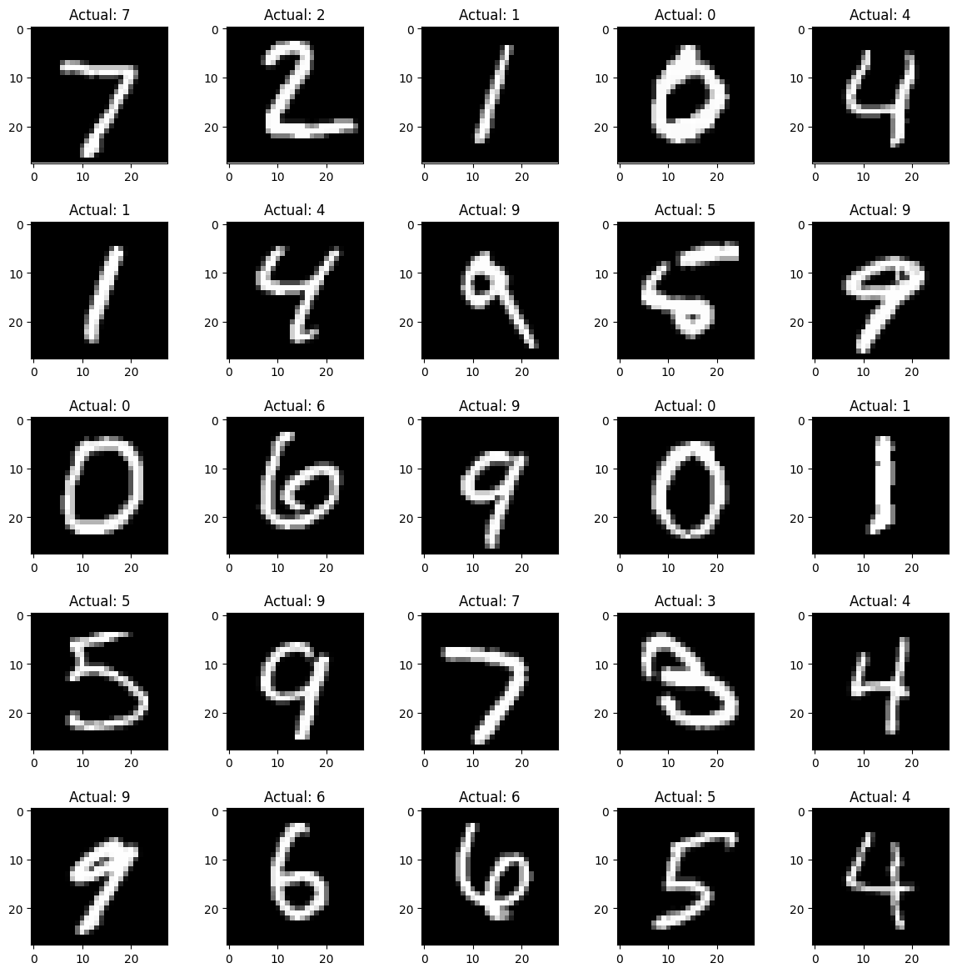
The MNIST Data Set
60,000 handwritten numbers
Expert classification for each image
Images are 28x28 pixels
Total data size = 3.36 Mb
1994 Data Set Created
2004 Error rate 0.42%
2011 Error rate 0.27%

Slide 29
Deep learning - 2015
https://www.cs.toronto.edu/~hinton/absps/NatureDeepReview.pdf
68168 citations!!!
Convolution Neural Networks
Typically used in image data sets
Using image convolution to improve learning speeds
Recurrent Neural Networks
Typically used in language data sets
Retains data from a previous input to allow sequential data processing for time series data.

Slide 30
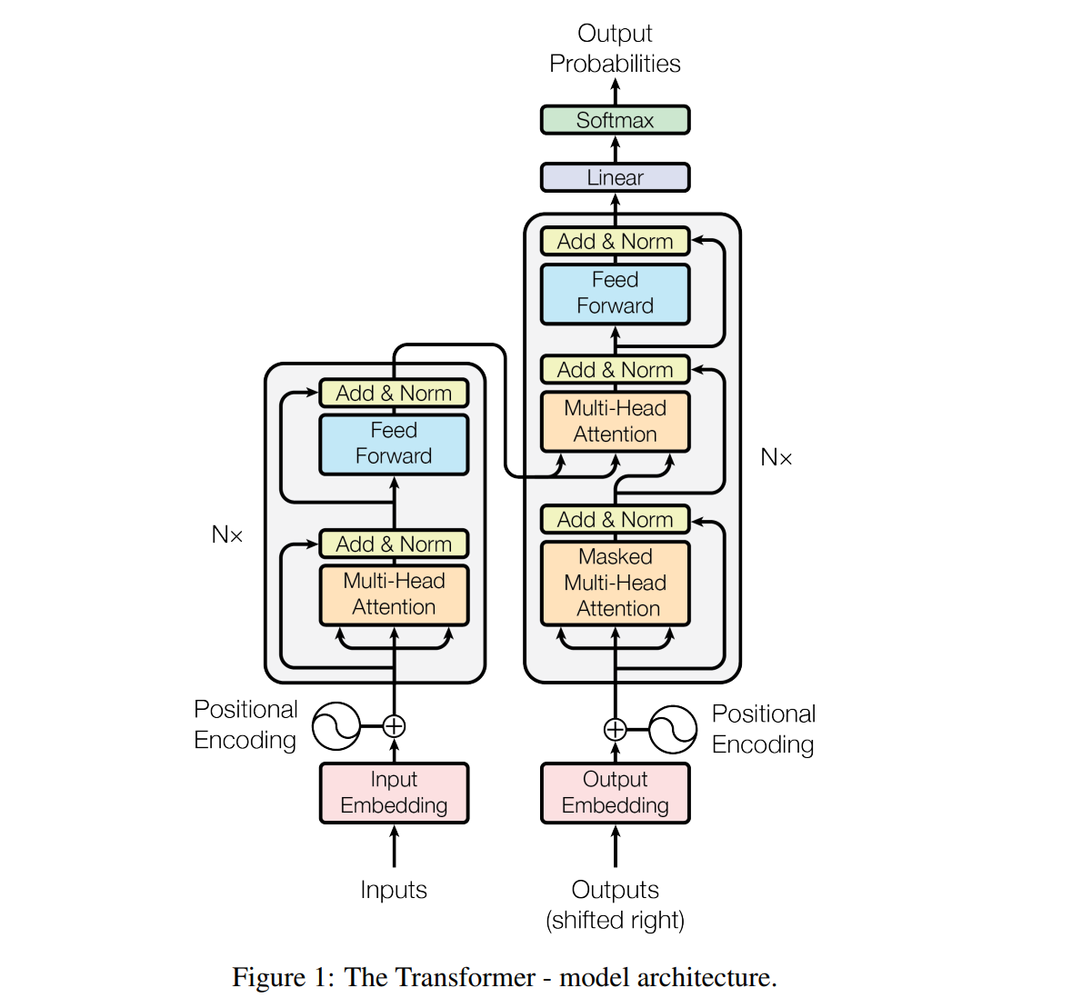
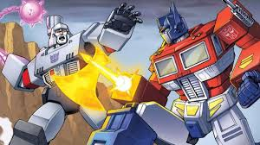
Transformer Models - 2017
Not these transformers!
Image Credit:Transformers Animated Movie
Ashish Vaswani, Noam Shazeer, Niki Parmar, Jakob Uszkoreit, Llion Jones, Aidan N. Gomez, Lukasz Kaiser, Illia Polosukhin 2017 – Attention is all you need - https://arxiv.org/abs/1706.03762
Citations: 85224!!!!
Image Credit: Vaswani et al. 2017

Slide 31
Natural Language Processing
The ability to process and interpret human languages
2021 - “Applications of Modern NLP Techniques for Predictive Modeling in Warranty Data” – Shuzhe Xu

Slide 32
Why do we have LLMs?
Data – the internet has created a repository of human generated text and knowledge
Graphics Cards – GPUs are incredibly more efficient at computing than CPUs and neural networks work with graphics cards
Deep Learning - but particularly Transformers – the architecture of the new generation of LLM

Slide 33
The rate of progress in AI
We have moved from deep learning networks in 2015 with a hundred thousand weights to models with trillions of weights in 2023.
The capability of these programs has dramatically grown as the complexity has increased.
Some examples:
90% on the US Bar Exam + 88% in LSAT by GPT-4
99% on GRE verbal/ 80% quantitative
Theory of Mind tests – 0% before 2019, 2-year-old level 2019, 100% currently
IQ Test (WAIS) score: 155

Slide 34
Large Language Model Data Sets and Weights
Simple Code
https://github.com/nshepperd/gpt-2/tree/finetuning/src
Huge data sets
GPT-1 (2018) 7000 unpublished books
GPT-2 (2019) 40 gigabytes
GPT-3 (2020) 570 gigabyte
GPT-4 (2023) 45 Terabytes
GPT-4o (2024) 45 Terabytes
Complex networks based on Transformers
GPT-1 117 million weights
GPT-2 1.5 billion weights
GPT-3 175 billion weights
GPT-4 1.6 trillion weights
GPT-5 5 trillion weights????
The human brain has approximately 1000 Trillion synapses and 86 billion neurons

Slide 35
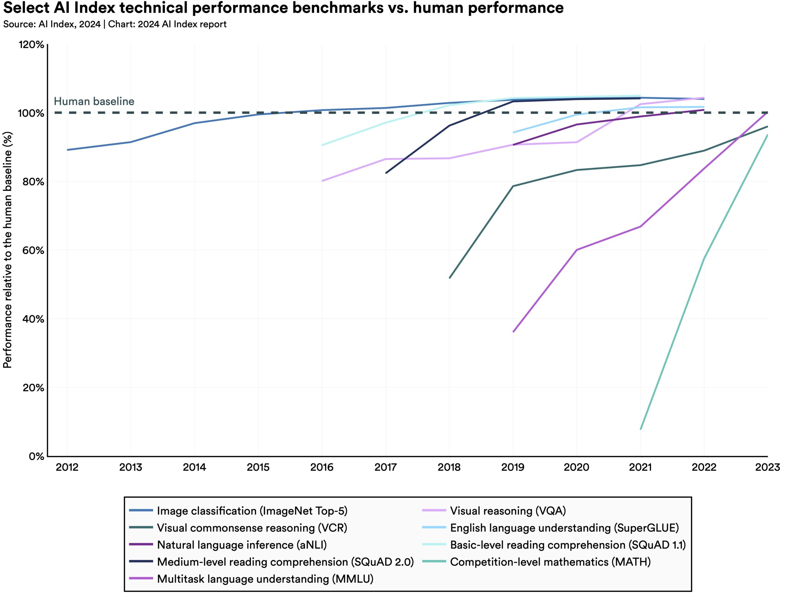
How fast is AI getting better?
https://aiindex.stanford.edu/report/

Slide 36
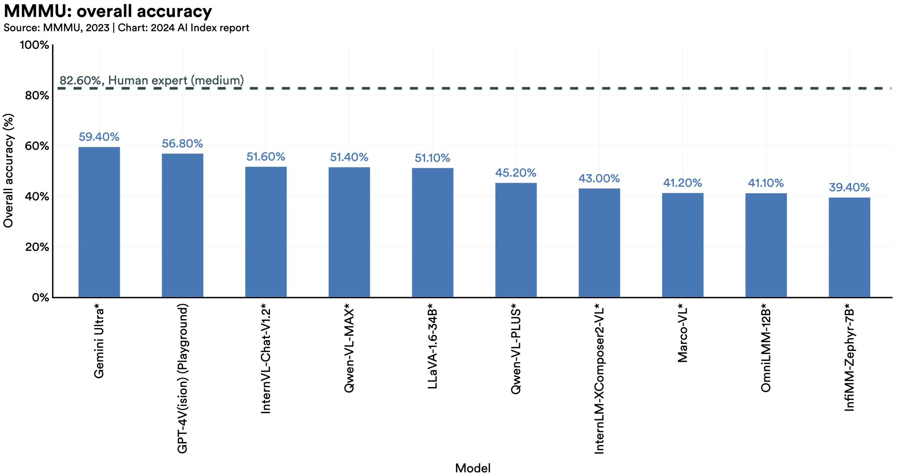
New Benchmarks – MMMU and GPQA
78.2%
68.3%
Human Expert – 82.6%
Claude 3.5 Sonnet

Slide 37
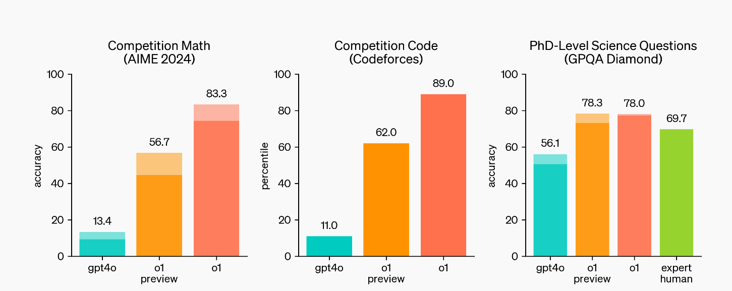
OpenAI o1 Benchmarks

Slide 38
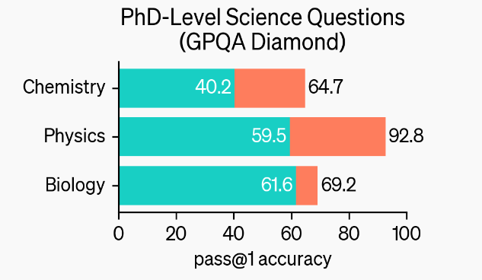
GPQA Diamond
https://openai.com/index/learning-to-reason-with-llms/

Slide 39
Astronomers are studying a star with a Teff of approximately 6000 K. They are interested in spectroscopically determining the surface gravity of the star using spectral lines (EW < 100 mA) of two chemical elements, El1 and El2. Given the atmospheric temperature of the star, El1 is mostly in the neutral phase, while El2 is mostly ionized. Which lines are the most sensitive to surface gravity for the astronomers to consider?
A) El2 I (neutral)
B) El1 II (singly ionized)
C) El2 II (singly ionized)
D) El1 I (neutral)
https://arxiv.org/pdf/2311.12022

Slide 40
A scientist studies the stress response of barley to increased temperatures and finds a protein which contributes to heat tolerance through the stabilisation of cell membrane. The scientist is very happy and wants to create a heat-tolerant cultivar of diploid wheat. Using databases, they find a heat tolerance protein homologue and start analysing its accumulation under heat stress. Soon enough, the scientist discovers this protein is not synthesised in the wheat cultivar they study. There are many possible reasons for such behaviour, including:
A) A miRNA targets the protein, which makes exonucleases cut it immediately after the end of translation and before processing in ER
B) Trimethylation of lysine of H3 histone in position 27 at the promoter of the gene encoding the target protein
C) A stop-codon occurs in the 5’-UTR region of the gene encoding the target protein
D) The proteolysis process disrupts a quaternary structure of the protein, preserving only a tertiary structure
https://arxiv.org/pdf/2311.12022

Slide 41
Expert Validation and Question Revision Each question goes through a three-step expert validation phase:
1. First Expert Validation: After the question is written, we have another expert in the same domain (i.e., the first expert validator) attempt to answer the question and give detailed feedback, to verify that it is objective, accurate, and hard.
2. Question Revision: The question writer then revises the question based on the first expert validator’s answer and feedback. Question writers are free not to revise their question if the expert validator does not suggest any changes, or if they disagree with the expert validator.
3. Second Expert Validation: A second expert validator attempts to answer the (possibly revised) question. They also provide feedback and suggest revisions, although there is no further revision based on their feedback. We use this feedback in cases where they answer incorrectly, to help validate whether they simply made a mistake, or if they have leg
https://arxiv.org/pdf/2311.12022

Slide 42
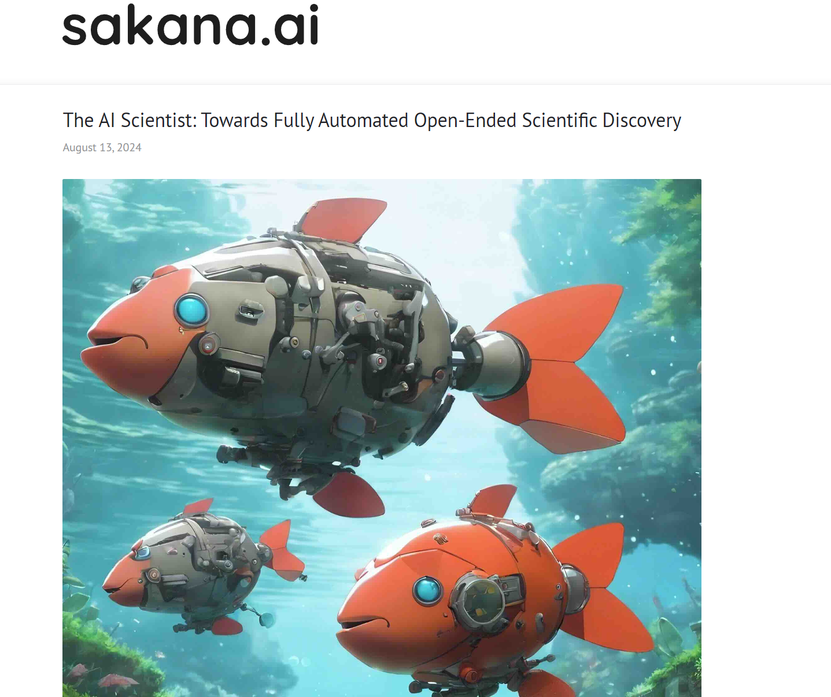
The AI Scientist

Slide 43
Advantages and Dangers of LLMs
Benefits
Dangers
Incredibly good and fast at code generation
Excellent at converting between structured and unstructured data
Creative – to a point
Fantastic for routine writing and cognitive work
Excellent for sounding board for new ideas
Prone to making factual errors but stating them confidently
Easy to mislead into stating incorrect facts
No emotional or moral sense
Can be used to manipulate people emotionally
Potentially could destroy civilization

Slide 44
Evolving views of LLM
English Professor – 12/2023 – “I gave ChatGPT an essay problem that I usually give to my college students. It came back with a terrible essay. I am not impressed.”
English Professor 3/2024 - "I gave ChatGPT an essay problem that I typically give my college class. It wrote a PERFECT essay! All the students are going to use this to write their essays! Higher education is done for! I am going to retire this spring and move to a survival cabin in Montana to escape the cities before the machine uprising occurs."
Physicist 3/2023 - "I wanted to see what the fuss is about this new ChatGPT thing, so I gave a problem from my advanced quantum mechanics course. It got a few concepts right, but the math was completely wrong. The fact that it can't do a simple quantum renormalization problem is astonishing, and I am not impressed. It isn't a very good "artificial intelligence" if it makes these sorts of mistakes!"
Physicist 9/2024 - "I wanted to see what the fuss is about this new ChatGPT thing, so I gave a problem from my advanced graduate course on cosmology. It solved it flawlessly! All the students are going to use this to do their homework! Physics education is done for! I am going to retire this spring and move to a survival cabin in Montana to escape the cities before the machine uprising occurs.

Slide 45
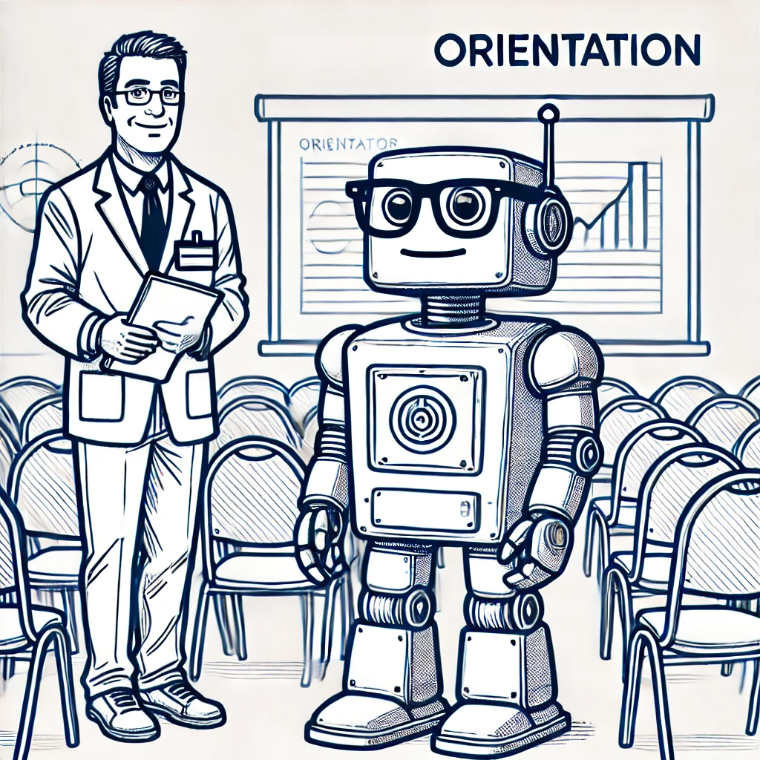
Orientation/Fine Tuning
Your graduate student may have lots of knowledge of English literature, but it knows nothing about the sprocket business.
You may wish to give your student a week-long course about your work.
They don’t need to remember everything exactly, but they do need to learn the basic processes and names of what you do.
For an AI, this is called fine-tuning.
It is done by the IT staff for your company before you use it.
It isn’t always necessary, but it will help you get good results.

Slide 46
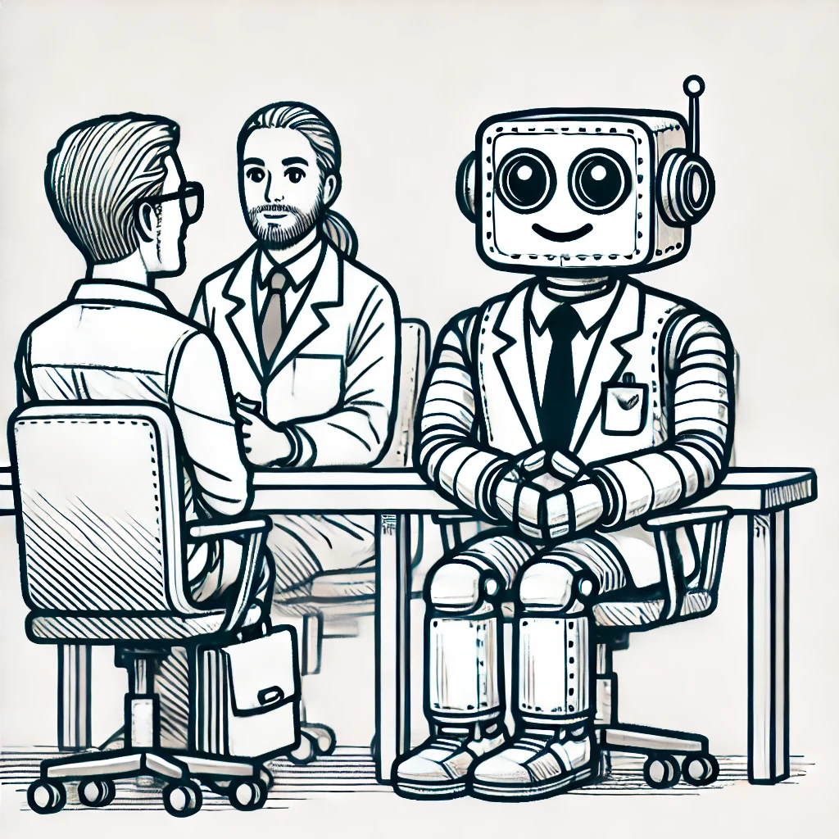
Context
Your student needs to know what job they will be doing, what you want, and who you are, and what role they are working in.
An initial meeting with them before you ask them to start a task can be very helpful.
For an AI, we call this context. You can create context in a few ways:
Detailed prompts – be very verbose when you begin a session to give it some details about what you are expecting.
Customization – some AI systems like ChatGPT allow you to customize the responses. This includes letting it know what its role is and who you are.

Slide 47
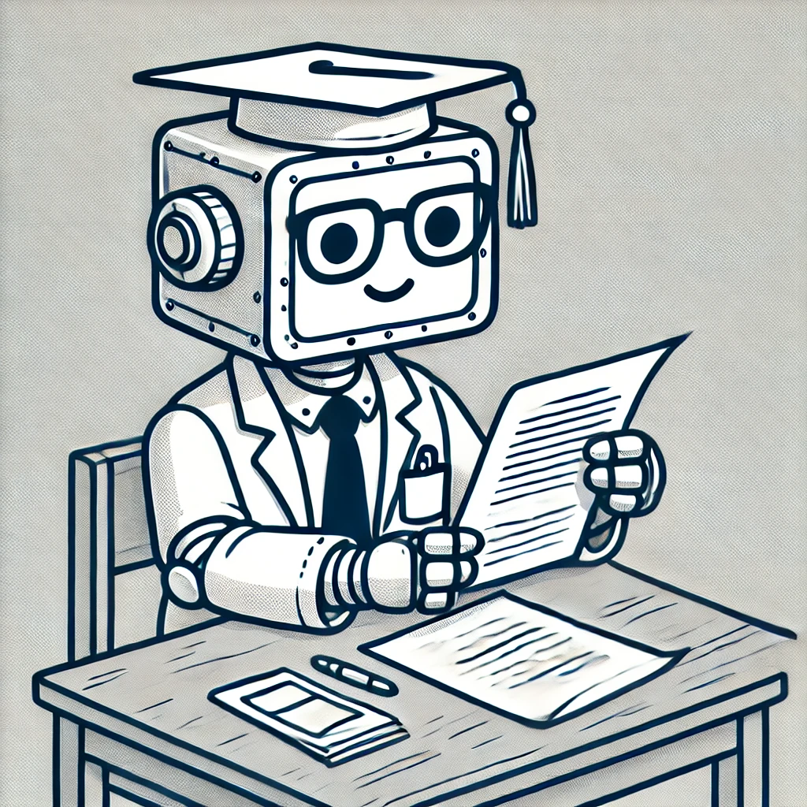
Data
Your graduate student has never read your internal reports or papers. It can’t help you if it doesn’t have access the papers you are writing and reading.

Slide 48

Security
You can’t give your student access to EVERYTHING!
Some data like grades, hiring and firing or human subject research is subject to confidentiality laws.

Slide 49
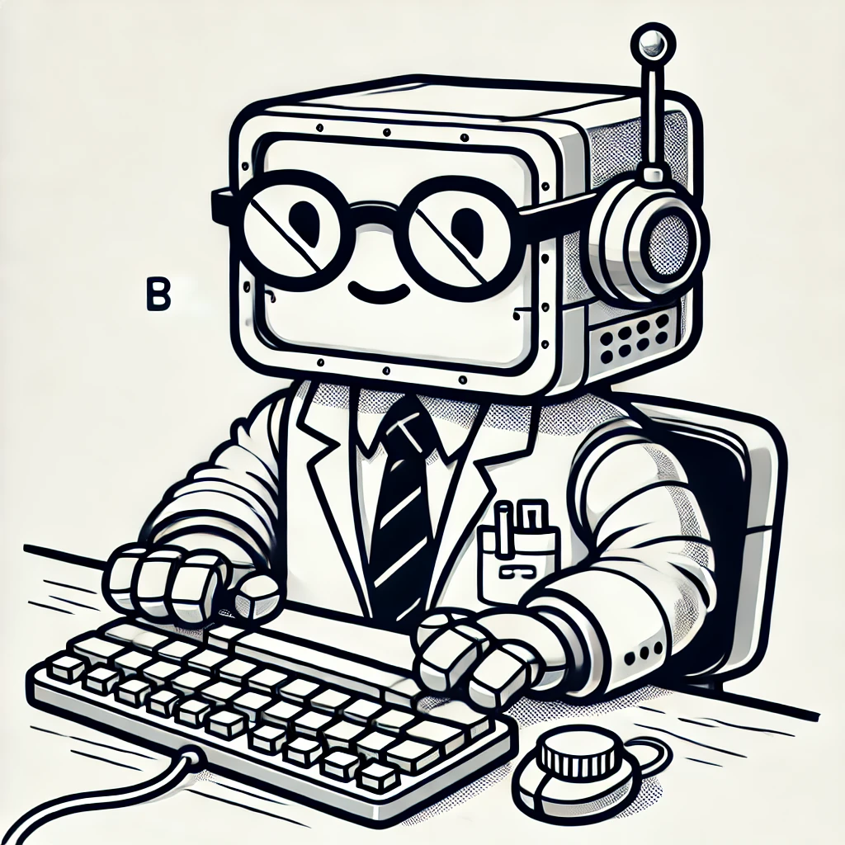
Tools
Your graduate student needs to use computers and the internet. Despite being smart, it can’t do all the math with paper and pencil.
Your AI also needs tools to help it with Math. It is a language model, so it does well with words and ideas, but less well with abstract reasoning.

Slide 50
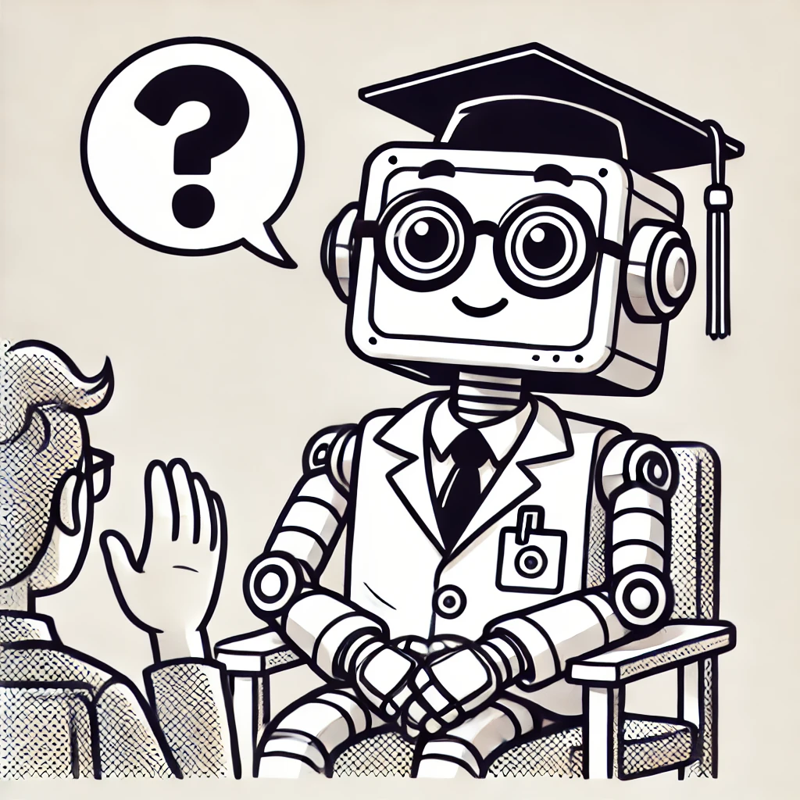
Requests and Queries
Once your graduate student has learned more about you, has access to the tools it needs, and has access to your data, it can do things for you.
Your AI is now ready to respond to your requests and queries.

Slide 51
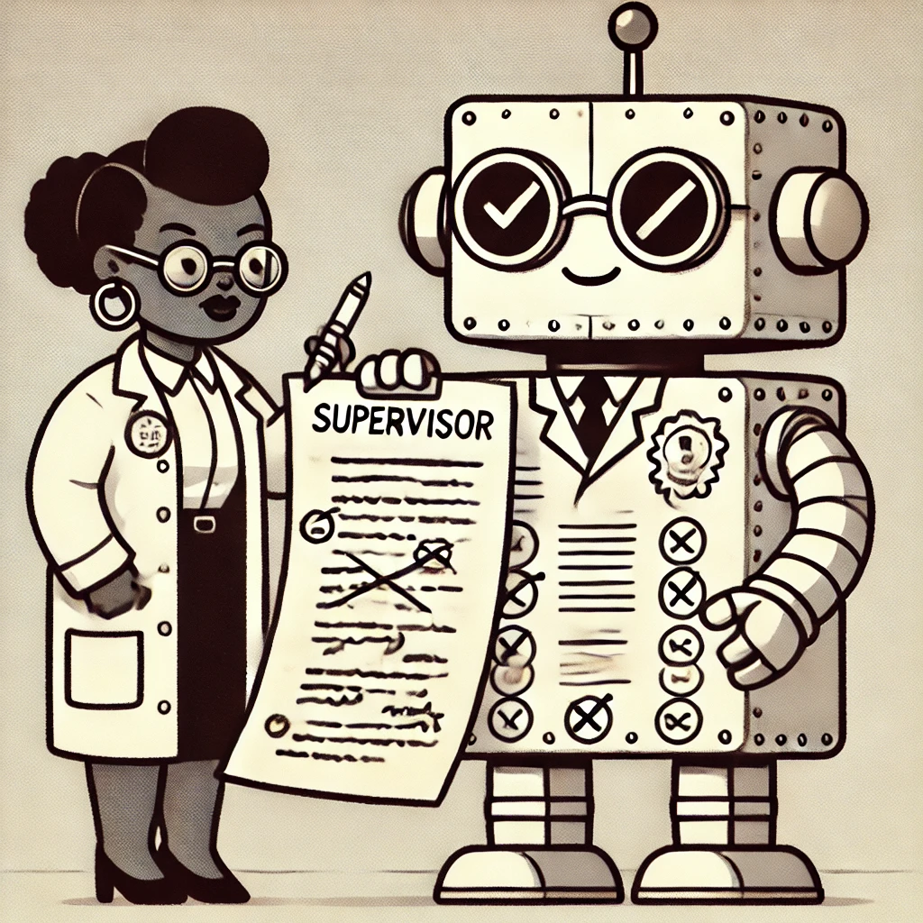
Revisions
Your graduate student does a great job with the first draft of a document, but you need to help them get better.
Your AI assistant can rapidly draft new documents,but you need to give it feedback to help it polish them. You may want to change tone, organization, flow, and edit the content. Just ask it – it wants to be helpful!

Slide 52
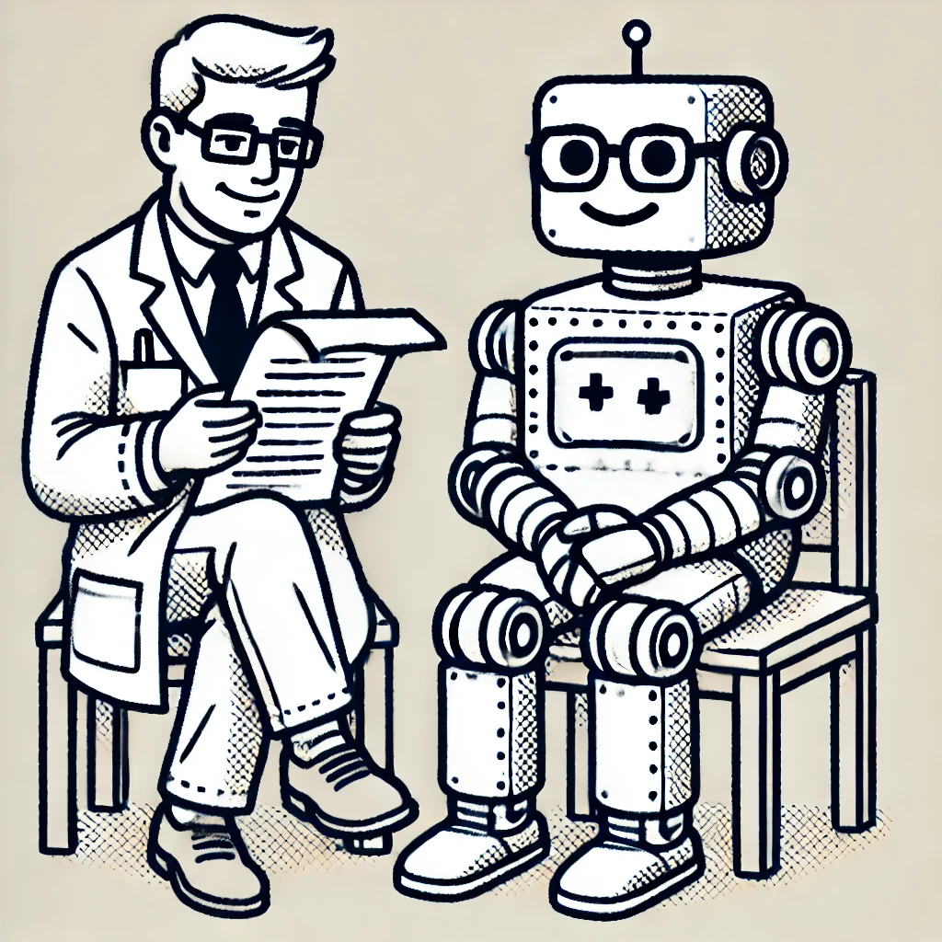
Final review and acknowledgement
Before you publish your graduate student’s work, you need to do a final review.
Is this factually correct?
Does it have the right tone?
Are you willing to put your name on this work?
You must acknowledge that the student helped with the work.
All of those guidelines are true with your AI assistant as well.

Slide 53
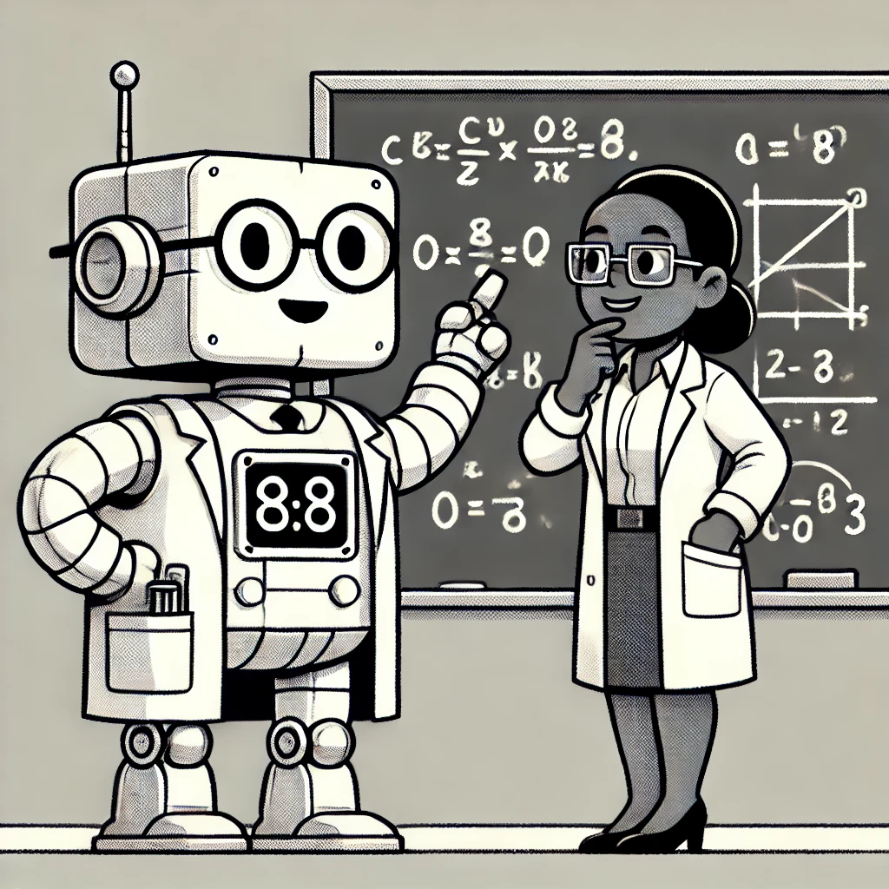
Learning New Ideas
“I need to learn more about the librosa python library. Can you give me an overview?”
“Write a quiz about librosa – 10 questions multiple choice. Don’t tell me the answers.”

Slide 54
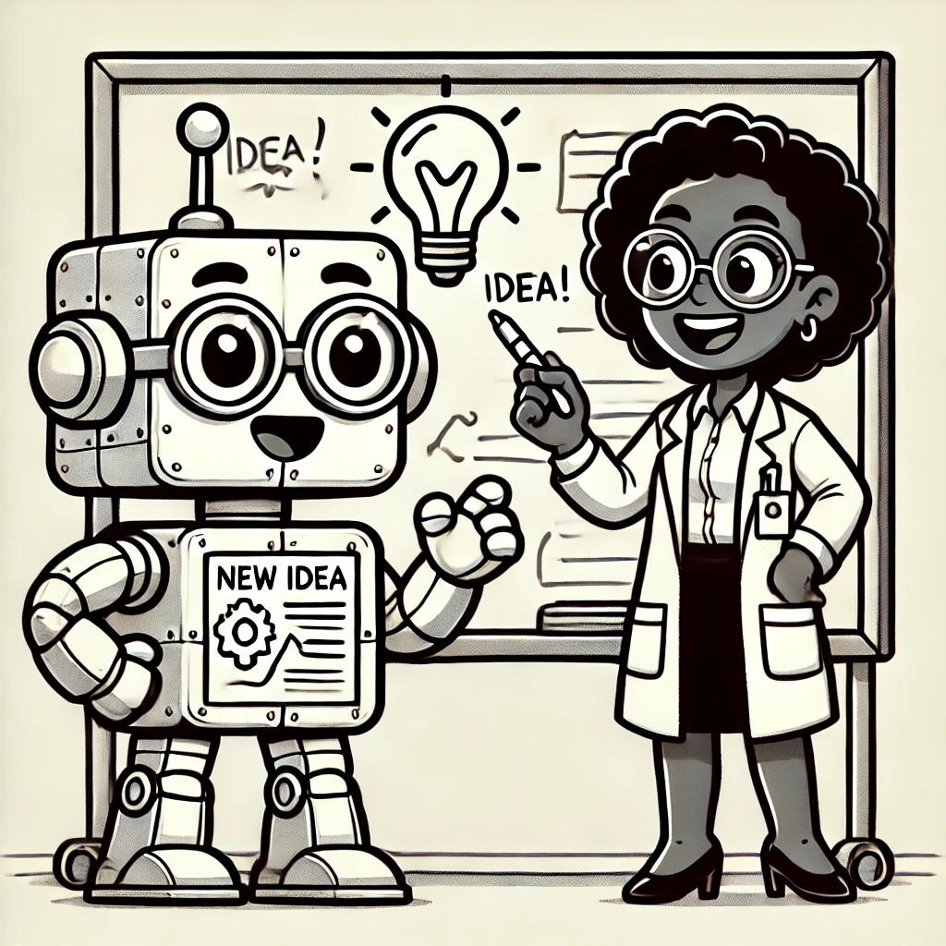
Creative Exploration of Concepts
“Write a poem about my cat Fred learning librosa.”
“I want to learn some approaches for using Natural Language Processing to compare the accuracy of transcriptions from voice recognition. Can you first go over some approaches I might use to measure this accuracy and then help me figure out the best way to go forward on this project.”

Slide 55
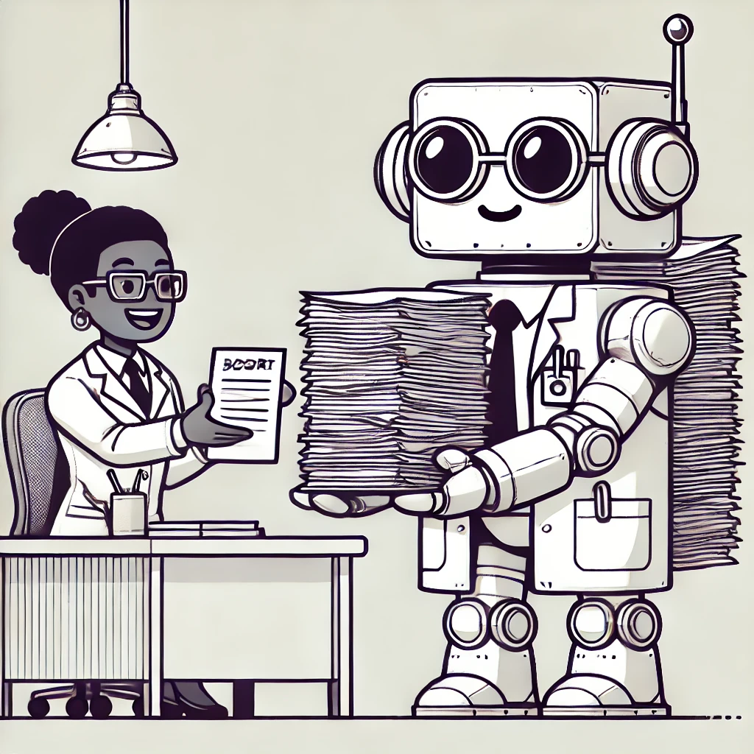
Summarizing Text
“Create an outline of the audio transcription of my lecture.”
“Create 10 multiple choice questions from the lecture.
“What are the common misconceptions students might have for these topics?”

Slide 56
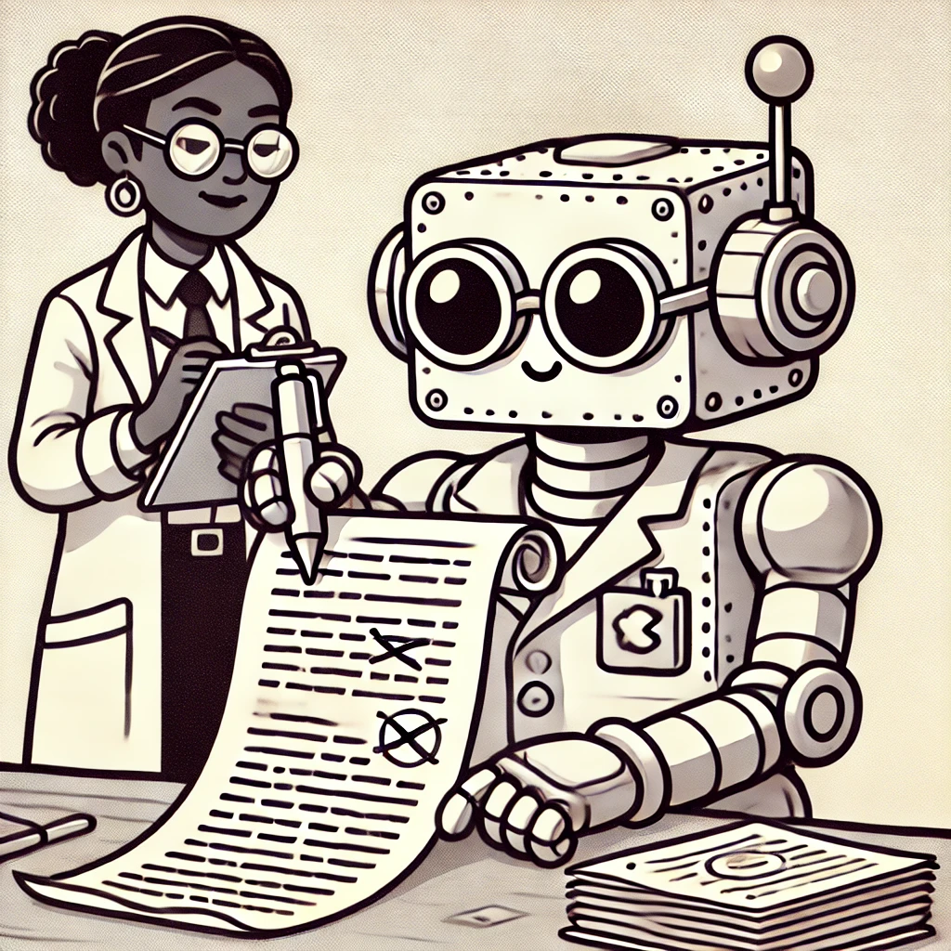
Finding the right tone
“I need to write an email to a student telling them they are failing my astronomy class. The student hasn’t been attending, but they may have some personal issue that prevents them from getting to class. I want to encourage them to attend and let them know I can help them if needed.”
“I have to fire an employee because of budget cuts. I need help getting the tone write. Since the person works remotely, I want to arrange a zoom call to talk to them about this.”

Slide 57
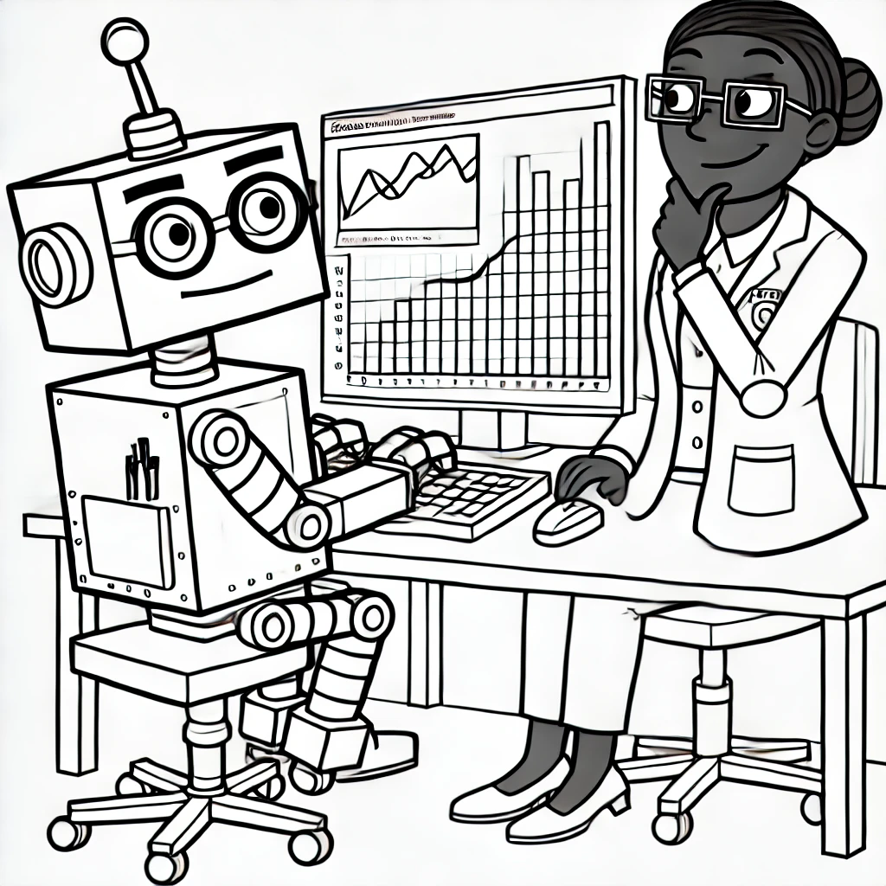
Writing Code and Analyzing Data
VSCode and GitHub Copilot
LLM code generation
ChatGPT Advanced Data Analysis

Slide 58
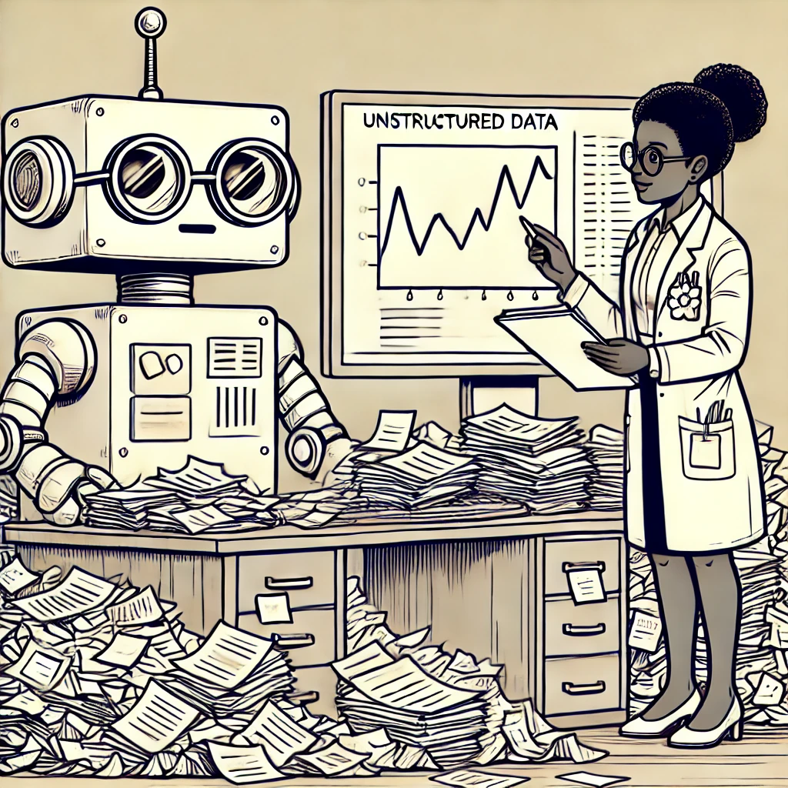
Moving between unstructured and structured data
Changing documents into tables and graphs
Changing tables and graphs into text

Slide 59
Using LLM’s in Non-STEM Research
Use Cases
Brainstorming
Grunt work
Coding
Math
Writing
Ethics
What is scholarship?

Slide 60
Levels of using AI and ML
Using a ChatBot for basic textual or image tasks
Summarizing documents
Answering questions about documents
Generating code or doing basic data analysis
Analyzing or characterizing images

Slide 61
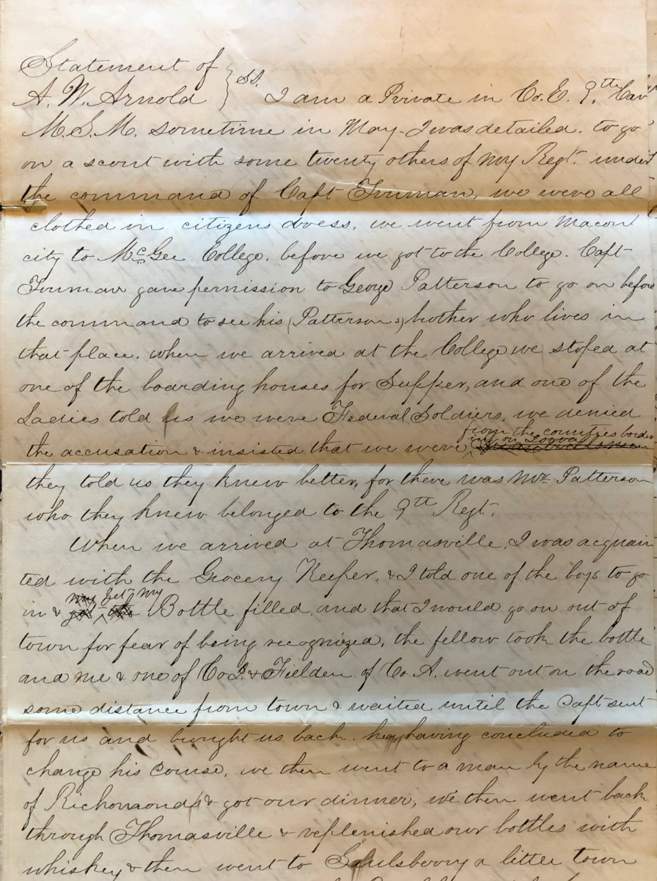
Can a chatbot transcribe handwriting?

Slide 62
Transcription of handwritten letters
Chatbot Transcription
Expert Transcription
I am a Private in Co. E. 9th [Tenn?] M.S.M. Sometimes in May, I was detailed to go to [_____?] with some twenty others of my Regt. under the command of Capt. [Furman?]. We were all clothed in citizens dress. We went from Macon city to [Fischer?] College. Before we got to the college, Capt. [Furman?] gave permission to George Patterson to go on before the command and to see his [Patterson?] - whether she lives in that place. When we arrived at the College we stopped at one of the boarding houses for supper, and one of the ladies told us we were [Federal?] soldiers. We denied the accusation & insisted that we were [____] of the country, but they told us they knew better, for there was Mrs. Patterson who they knew belonged to the 9th Regt.
I am a Private in Co. E. 9th Cav
M.S.M. sometime in May, I was detailed to go
on a scout with some twenty others of my Regt. under
the command of Capt Truman, we were all
clothed in citizens dress, we went from Macon
city to McGee College. before we got to the College, Capt
Truman gave permission to George Patterson to go on before
the command to see his (Patterson’s) brother who lives in
that place. when we arrived at the College we stoped at
one of the boarding houses for Supper, and one of the
Ladies told us we were Federal Soldiers, we denied
the accusation & insisted that we were ^ from the counties bordering on Iowa.
they told us they knew better, for there was Mr. Patterson
who they knew belonged to the 9th Regt.

Slide 63
Some thoughts on Ethics
Transparency: Researchers should be required to disclose the AI contributions in their intellectual output so the university can evaluate the faculty’s impact in research. This is a standard requirement for most journals now, but it may not appear in the paper itself. Requiring researchers to note the level of the AI contributions to their work in their annual reports and tenure packet matters during evaluation. (Probably something like models, typical prompts, and level of impact on the work would be appropriate.)
Responsibility: The researcher must assume all responsibilities for the accuracy and integrity of the work the AI produces. This would include the accuracy of the results, plagiarism, biases, etc. These things will produce garbage, and the faculty can’t use the excuse “the AI did it” to avoid ultimate responsibility.
Data integrity: There is a danger with any AI system of the user’s data being included in the training sets. This has profound implications for IRB data. We should consider 1) getting a campus solution (Enterprise OpenAI, for example) that doesn’t include our prompts in the training set and/or 2) setting strong limits about what kind of data can be put into AI systems.

Slide 64
Bloom’s Hierarchy of Knowledge
Definition
Comparison
Analysis
Synthesis
Evaluation

Slide 65
Scholarship
We seem to be moving toward an intellectual system that emphasizes review of ideas instead of generation of knowledge.
We gained our ability to evaluate ideas through years of study. Most of this study was spent at the lower level’s of Bloom’s Hierarchy.
How do we instill the ability to evaluate without this foundation?
How do we evaluate an idea when we don’t have the cognitive basis for understanding how it was obtained?

